Slide 1


Data Direct I/O Characterization for Future I/O System Exploration
Mohammad Alian, Yifan Yuan, Jie Zhang, Ren Wang, Myoungsoo Jung, Nam Sung Kim

Slide 2

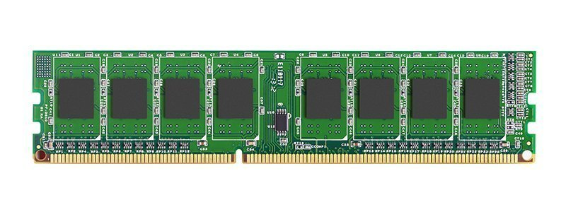
The Context of This Paper
SSD
NIC
System Buses
Study the data movement between I/O devices and processor/memory in modern servers

Slide 3
How did an I/O device traditionally communicate with CPU?

Slide 4
Example: Traditional Network Packet Reception
2. Memory to LLC
3. LLC to private cache and core
1. device to memory
Data
NIC
2x memory operations for data received from network!

Slide 5
Example: Traditional Network Packet Transmission
Buf
data
data
1. Fetch network buffers
3. DMA transaction invalidates caches
4. data copied to device/ written back to memory
2. Update network buffers
NIC
Optimized for slow I/O and LLC utilization

Slide 6
How does a modern I/O device communicate with CPU?

Slide 7
Example: Network Packet Reception with Intel DDIO
Cacheline in LLC?
✅: Update the cacheline
❌: Allocate a cacheline and write data to that slot
2. LLC to private cache and core.
1. Device to LLC.
NIC
Data
DDIO reduces memory bandwidth utilization

Slide 8
Example: Network Packet Transmission with Intel DDIO
Data
Buf
Data
2. DMA transaction invalidates private caches
1. Network buffer gets updates
The network buffer is most likely cached in the cache hierarchy
3. Data copied to the NIC
NIC
Network buffers stay in the LLC for future reference

Slide 9
Experimental Setup
Hardware:
CPU: Intel Xeon Platinum 8260 x 2
Memory: 3 channels per socket, 96GB DDR4
NIC: Intel XL710 40GbE
SSD: Intel Optane DC P4800X 375GB NVMe
Software:
DPDK sample applications for networking tests
FIO micro-benchmark for storage tests
YCSB + (local) Redis as co-running application

Slide 10
SSD Read
Memory Read
Memory Write
Memory bandwidth is not a bottleneck in SSD operations

Slide 11
SSD Write
Memory Read
Memory Write
No LLC invalidation after DMA reads in modern Intel processors

Slide 12
Network Packet Reception (RX)
Memory Read
Memory Write
Memory bandwidth is not a bottleneck in high bandwidth networking

Slide 13
Network Packet Transmission (TX)
Memory Read
Memory Write

Slide 14
Co-running Application
7.4% performance degradation
DDIO reduces memory contention in co-running senarios

Slide 15
Re-architecting gem5’s I/O Model with DDIO

Slide 16
gem5
The state-of-the-art architectural simulator
“The gem5 Simulator: Version 20.0+,” arXive preprint
Comprehensive model library
Memory and I/O devices
Full OS, Web browsers
Clients and servers
Not accurate I/O modeling
DDIO is not modeled

Slide 17
Current gem5 model
Components:
IOBus: noncoherent xbar
MemBus: coherent xbar
IO$: small cache sitting between IOBus and MemBus
IOBus
MemBus
L2Bus
LLC
$
C
$
C
Device
IO$
MC
DRAM
** IOCache (aka. IO$) is a small cache sitting between IOBus and MemBus

Slide 18
Current gem5 model: TX path
Models a DDIO enabled system
Cores write/allocate in the L1/MLC/LLC
DMA engine read requests miss in IO$ and are satisfied from LLC/MLC
IO$ is filled with cachelines in S state
MLC/LLC copies downgrade into S or O states
IOBus
MemBus
L2Bus
supply
$
C
LLC
$
C
Device
IO$
snoop
snoop
MC
DRAM
read
miss

Slide 19
Current gem5 model: RX path
DMA writes into IO$
If wholeCacheline write:
Send invalidates to CPU side caches
Write allocate/upgrade in IO$
The cacheline stays in M state in IO$
Else: // partial write request
If miss in IO$:
Read an exclusive copy of the cacheline
Update the cacheline with partial write and allocate in M state in IO$
Else: // hit in IO$
Send invalidate request to CPU side caches
Update the cacheline with partial write and upgrade it to M state
IOBus
MemBus
L2Bus
LLC
$
C
$
C
Device
IO$
inv
inv
snoop
snoop
MC
DRAM
write
miss

Slide 20
Current gem5 model is a Mixture of DDIO Enabled and Disabled System
CPU side caches are invalidated but moved to IO$
DMA engine does not write into LLC
CPU read newly written DMA data from IO$ instead of DRAM
You can have a small IO$ to fairly model an optimized DDIO disabled system
But not a traditional DDIO disabled system that invalidate caches after DMA reads
Disabled
Enabled
DDIO disabled? DDIO enabled?

Slide 21
DDIO Modeling in gem5

Slide 22
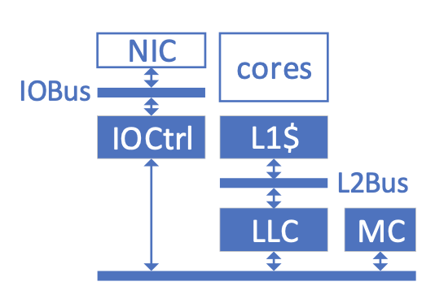
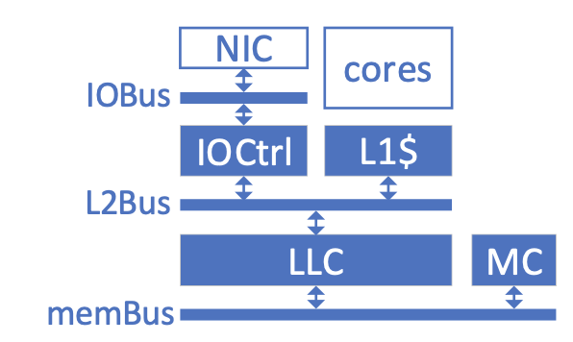

DDIO disabled optimized: inclusive cache (default)
DDIO disabled: exclusive cache
Device
Device
IO$
Enhanced LLC
Disabled
Enabled

Slide 23
Experimental Results

Slide 24
Methodology
gem5 baremetal full-system mode
NIC driver that mimics a user-space network software stack (i.e., DPDK)
RX/TX descriptor size: 1024
Configs
disabled-op, disabled, enabled
DDIO disabled but DMA reads do not invalidate LLC data
DDIO disabled
DDIO enabled
gem5 baremetal
gem5 baremetal
2x DDR4
2x O3 cores
2.4GHZ
32MB LLC
16ways LLC
DRAM
I/O bus
NIC
40Gbps
NIC
1514B packets
server
client

Slide 25
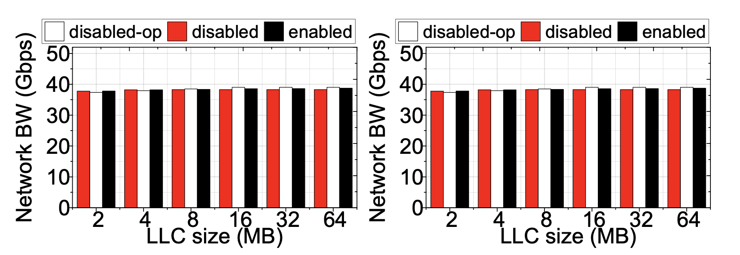
Achieved Network Bandwidth
RX
TX

Slide 26
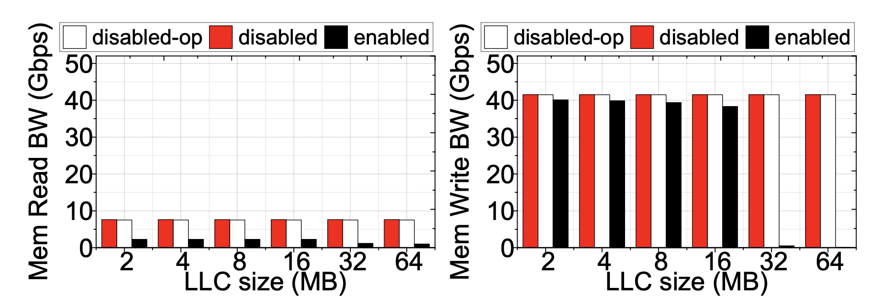
Packet Reception (RX)
2 ✕ 1024 ✕ 1514 ≃ 3MB
0.1 ✕ 32MB ≳ 3MB
Only reading headers from the memory
Memory read
Memory write

Slide 27
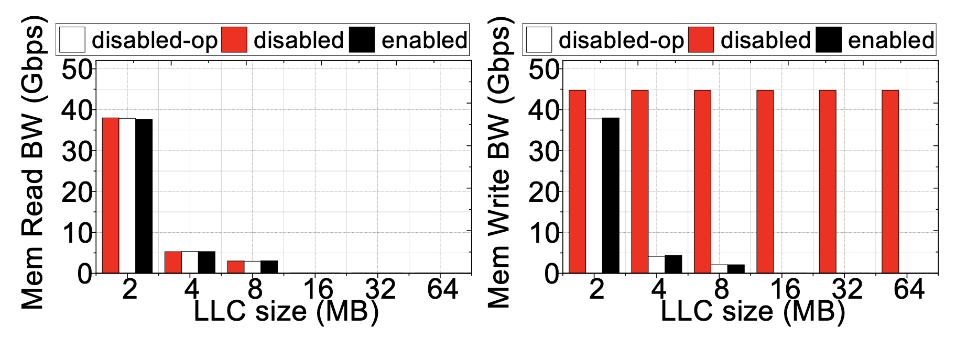
Packet Transmission (TX)
Conflicting writes as ring buffers does not fit in a 2MB LLC
No data reuse in our network stack
Lesser conflict with larger LLC
Memory read
Memory write

Slide 28
Summary
Intel DDIO:
An important technology that facilitates the communication between modern server CPU and high-speed PCIe-based I/O devices.
We conducted DDIO characterization on a real machine to quantify its benefit.
Implementing DDIO in gem5 simulator
Download the gem5 patch:
https://www.dropbox.com/s/5gjpqopu4nlrkx3/ddio-patch.patch?dl=0

Slide 29
Data Direct I/O Characterization for Future I/O System Exploration
Mohammad Alian, Yifan Yuan, Jie Zhang, Ren Wang, Myoungsoo Jung, Nam Sung Kim

